Slide 1
2023 Employee Benefits Plan
October 20, 2021

Slide 2
Health Benefits Program
Self-Insured Medical Plan
Claims paid dollar for dollar up to the stop loss deductible
Contract with medical insurance carrier (Cigna) to administer the plan, access network discounts, and provide population health improvement programs
Three medical insurance plan options
  Plan A: Buy-Up PPO
  Plan B: Base PPO
  Plan C – High Deductible Health Plan (w/Health Savings Account)
Employees contribute between 5% and 18% of premium depending on union status and plan choice
Fully-Insured Supplemental Benefits
Dental & Vision (cost share between Park District and employee)
Life, long-term disability, supplemental short-term disability, and accident insurance
Pet insurance, flexible spending accounts, and employee assistance program

Slide 3
Self-Insured Medical Claims Experience
Metroparks Trend
12.3% increase from 2014 through 2022
1.5% per year average increase
Ohio Public Employer Trend
42.3% increase from 2014 through 2022
5.3% per year average increase

Slide 5
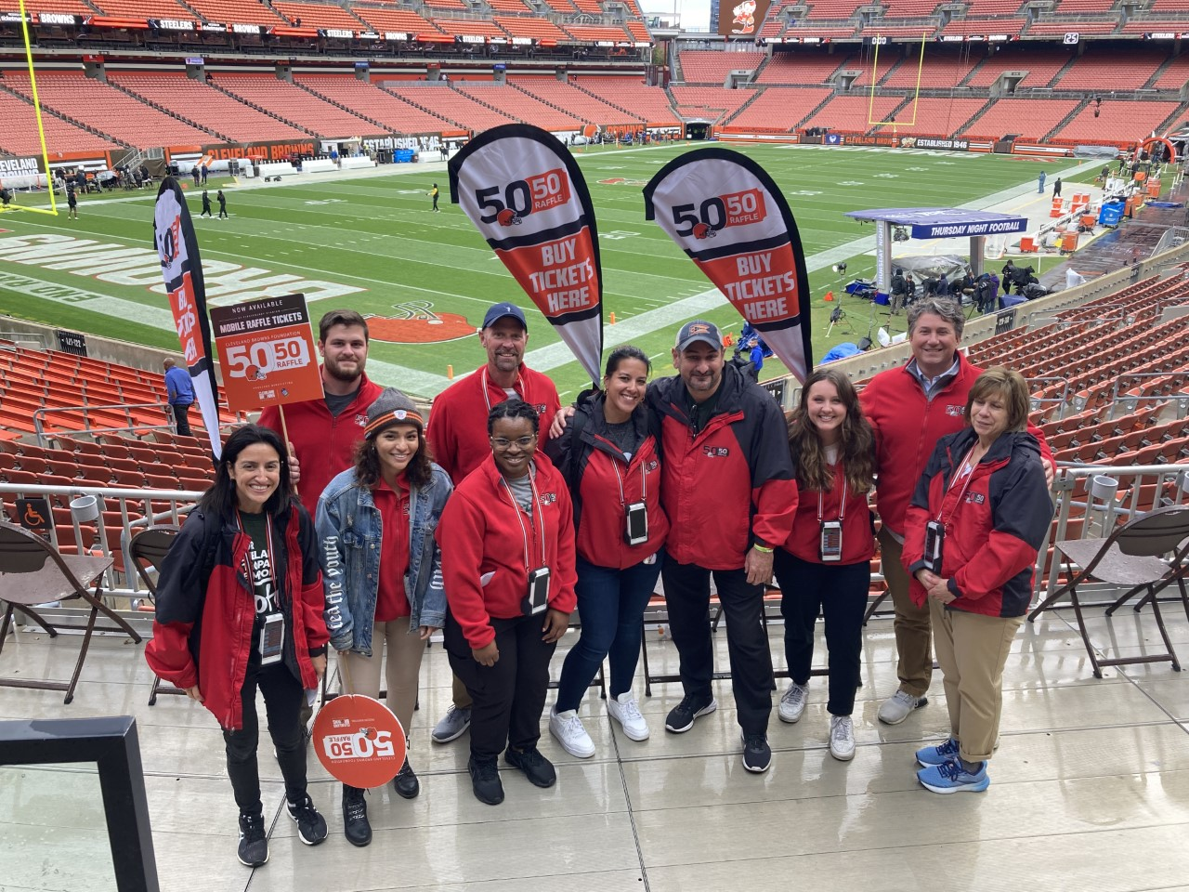

Employee Well-Being
Physical
Preventive care rate is almost double the Cigna benchmark rate
Non-smoking incentives for employees and spouses
High quality, affordable health insurance plans and access to premier health care facilities
Purpose
Highest employee engagement scores are in mission/purpose areas
12 straight NorthCoast99 awards as top employer
Financial
All full-time employees paid above single adult living wage rate for Cuyahoga County
72% participation in Ohio Deferred Compensation Program – approximately $4,000 per employee annually saved
Community
146 employees volunteered for pilot community volunteer program
Over $65K in employee contributions to Charity Choice Program
Social
174 employees participate in Club Metro
Over 50 participants in Corporate Challenge

Slide 6
2022 Benefits Renewal
Contract Approvals
1-year renewal Medical Mutual to provide Stop Loss insurance (7.7% premium reduction)
Plan Designs
Minor modification to plan design (elimination of prescription deductible)
No increase in premiums
Well-Being
Focus on employee mental health well-being

