Slide 1
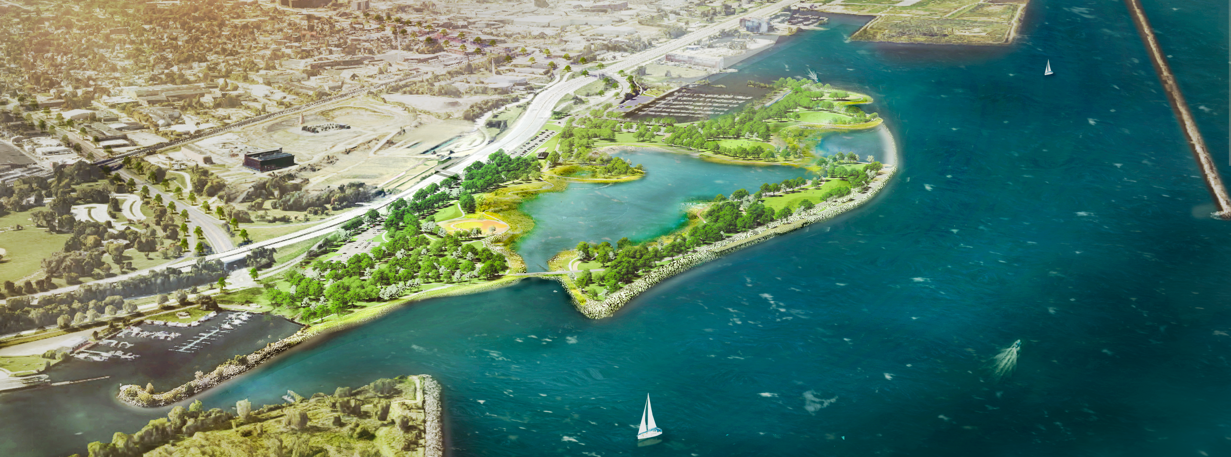

CHEERS
Cleveland Harbor Eastern Embayment Resilience Strategy
March 12, 2026 Stakeholder Meeting

Slide 2
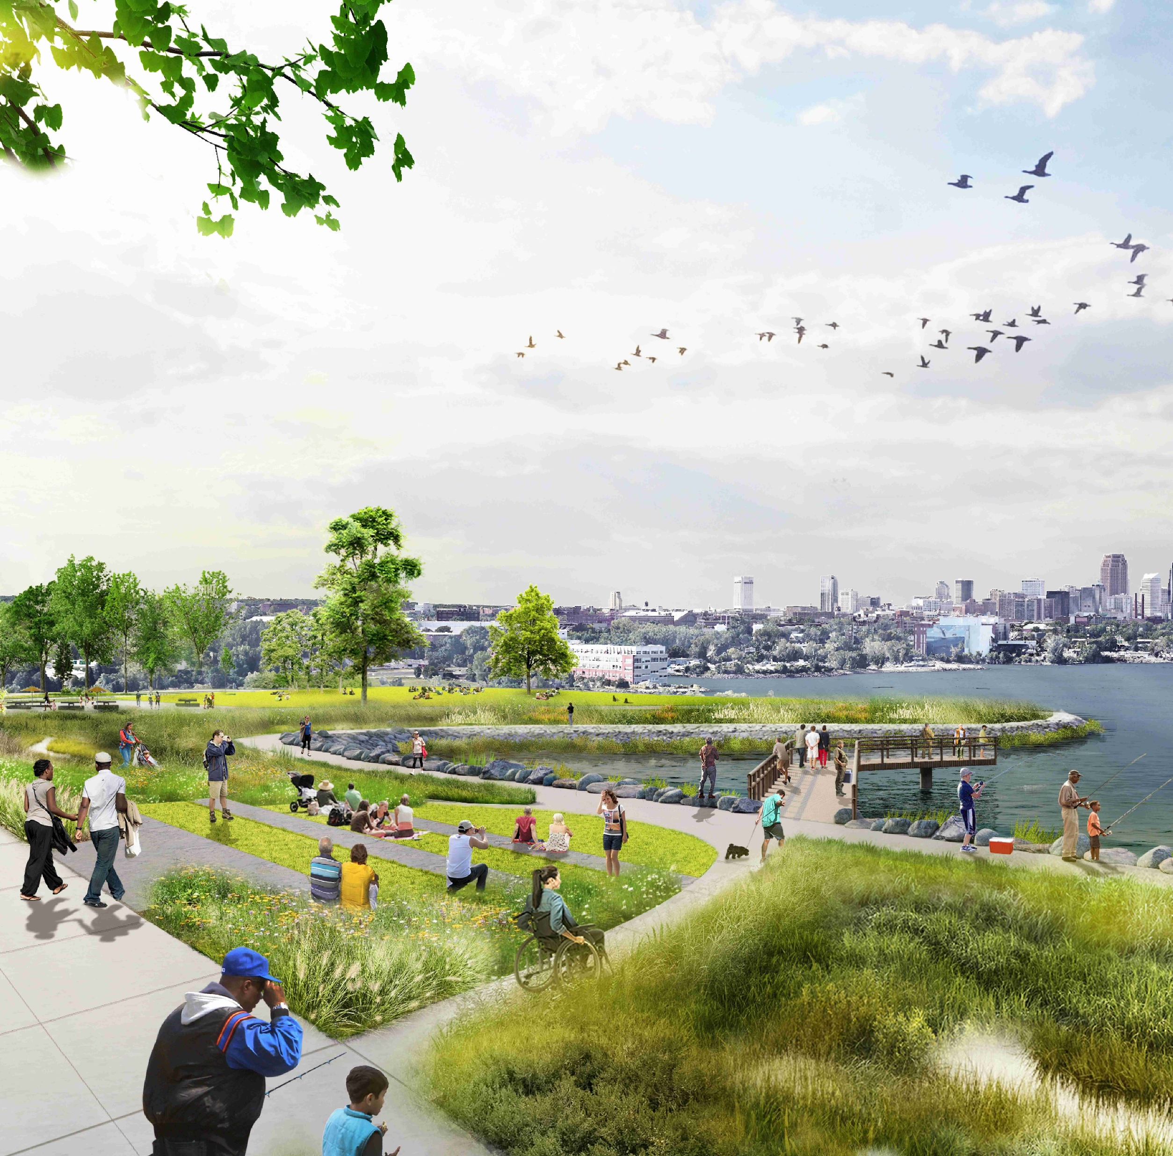
Agenda
General CHEERS Schedule & Next Steps
Habitat Loop Early Action Project Update
  Funding Update
Regulatory + Permitting Updates
  USACE Updates
Recent Deliverables
  Workforce Development – Draft Report
  Updated graphics
PARTNER AND STAKEHOLDER UPDATES
Ongoing Communications and Next Steps

Slide 3
2025/2026 Schedule
Major Grant and Project Milestones
NFWF Grant Term Ends
WE ARE HERE
SEP OCT NOV DEC JAN FEB MAR APR
8: CHEERS Marine Package + Permitting
90% Design
(Plans, Spec, Cost Estimate)
9 : Evolving Stakeholder and Community Engagement
Graphic Collateral
(Site Renderings, Flyers, etc)
On-Site Signage Development
10: Project Funding and Grant Support
Workforce Development Plan
3
4
5
6
7
8
11A+B: 90% Phase 1 Marine and Landside Park Design
30% Design
(Plans, Cost Estimate)
60% Design
(Plans, Spec TOC, Cost Estimate)
90% Design
(Plans, Spec, Cost Estimate)
11C: Vision Optimization for CHEERS
Plan Graphics Drafts
Plan Graphics
(Rendering Update)

Slide 4
Habitat Loop/Early Action Project Updates

Slide 5
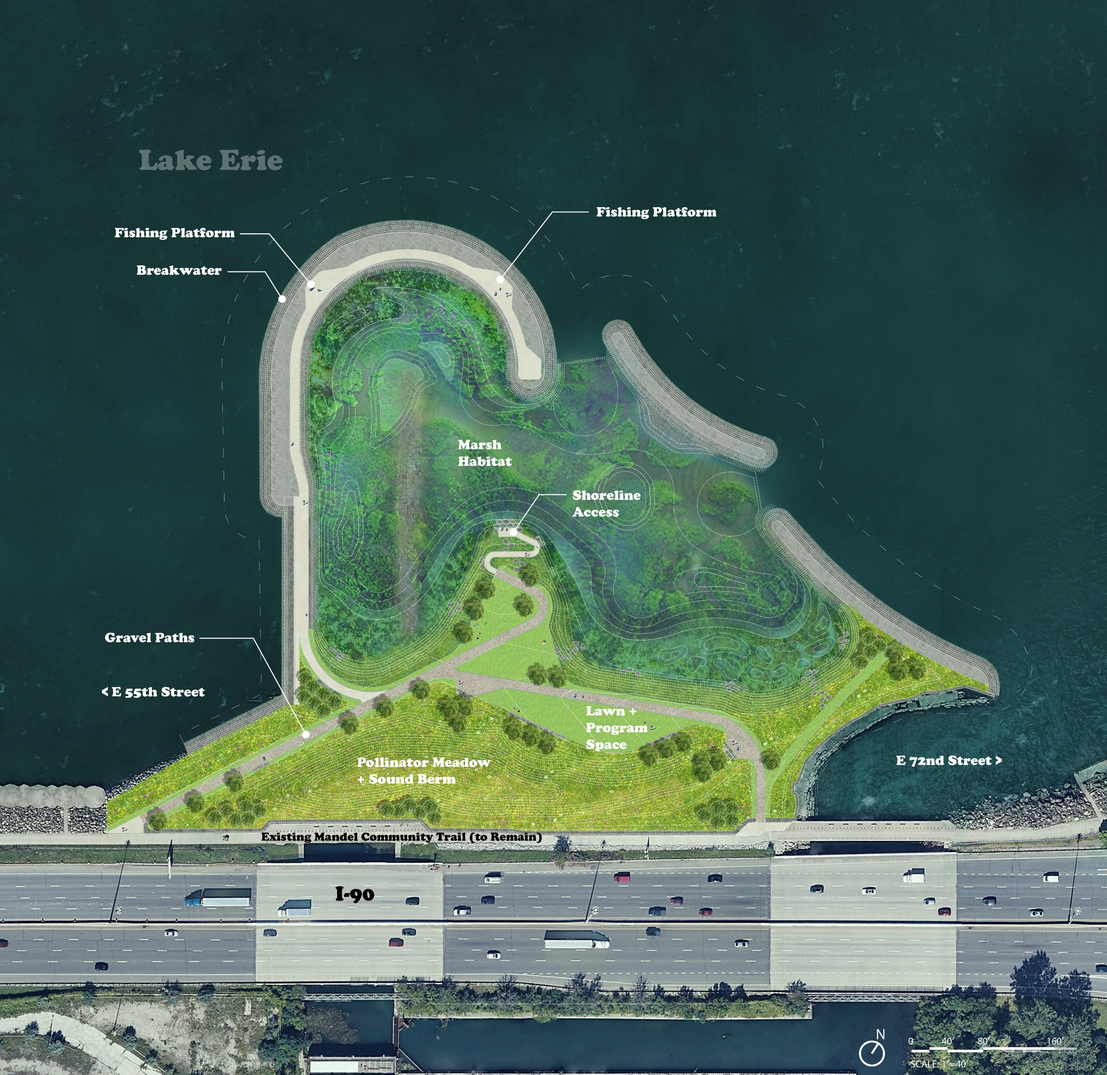
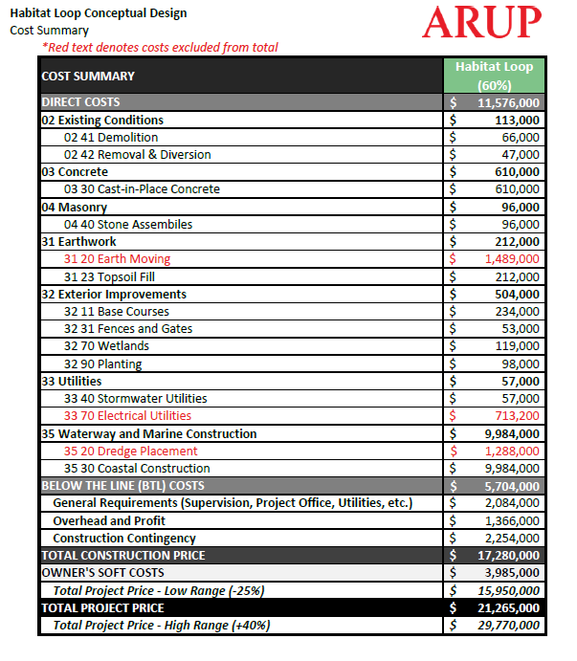
CHEERS Early Action Project
Overall Scope & Cost

Slide 6
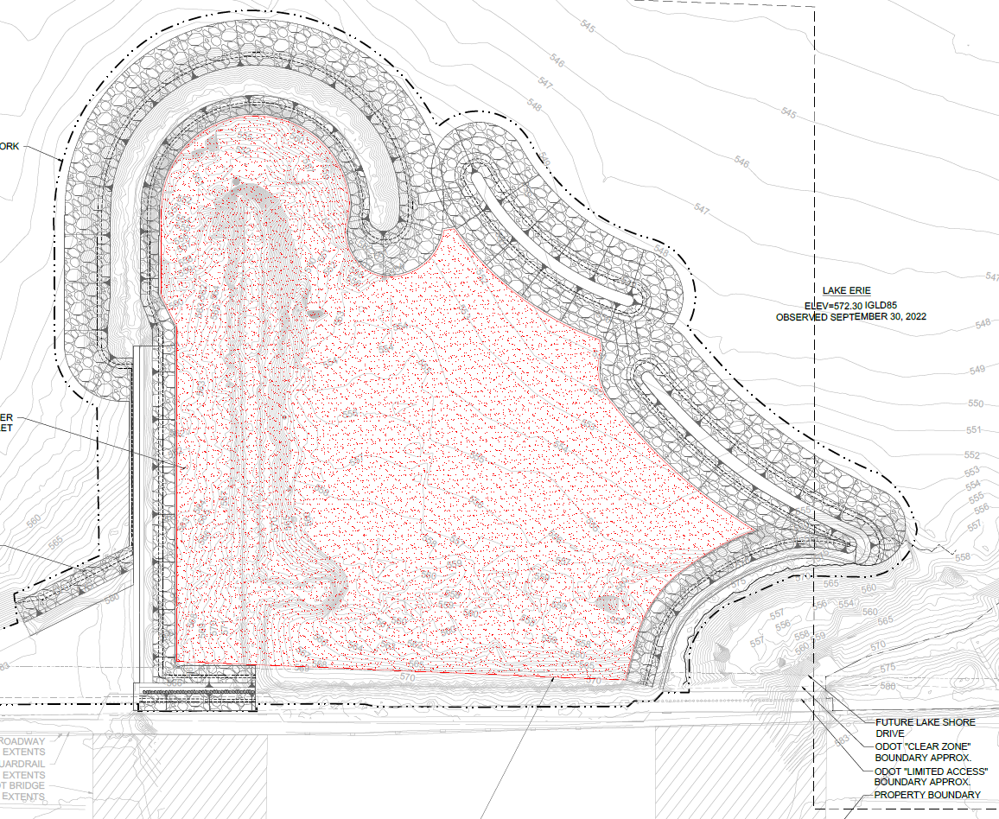
Funding Summary
Funding in hand:
- $1.5 M – City of Cleveland
- $1.5 M – ODOT MAP
- $1.1 M – Cleveland Metroparks / federal line item
$4.1 M for Habitat Loop outer breakwall
Submitted / pending:
NOAA Transformational Habitat
ODOT – PROTECT
BUILD – submitted February 24 – THANK YOU for letters of support!
  $13.06 M request, no local match
  Cleveland Harbor – Interstate 90 Maritime and Freight Fortification
  Confirmed NOACA and city support
  Announcements in late June 2026
    Construction likely to begin in 2028

Slide 7
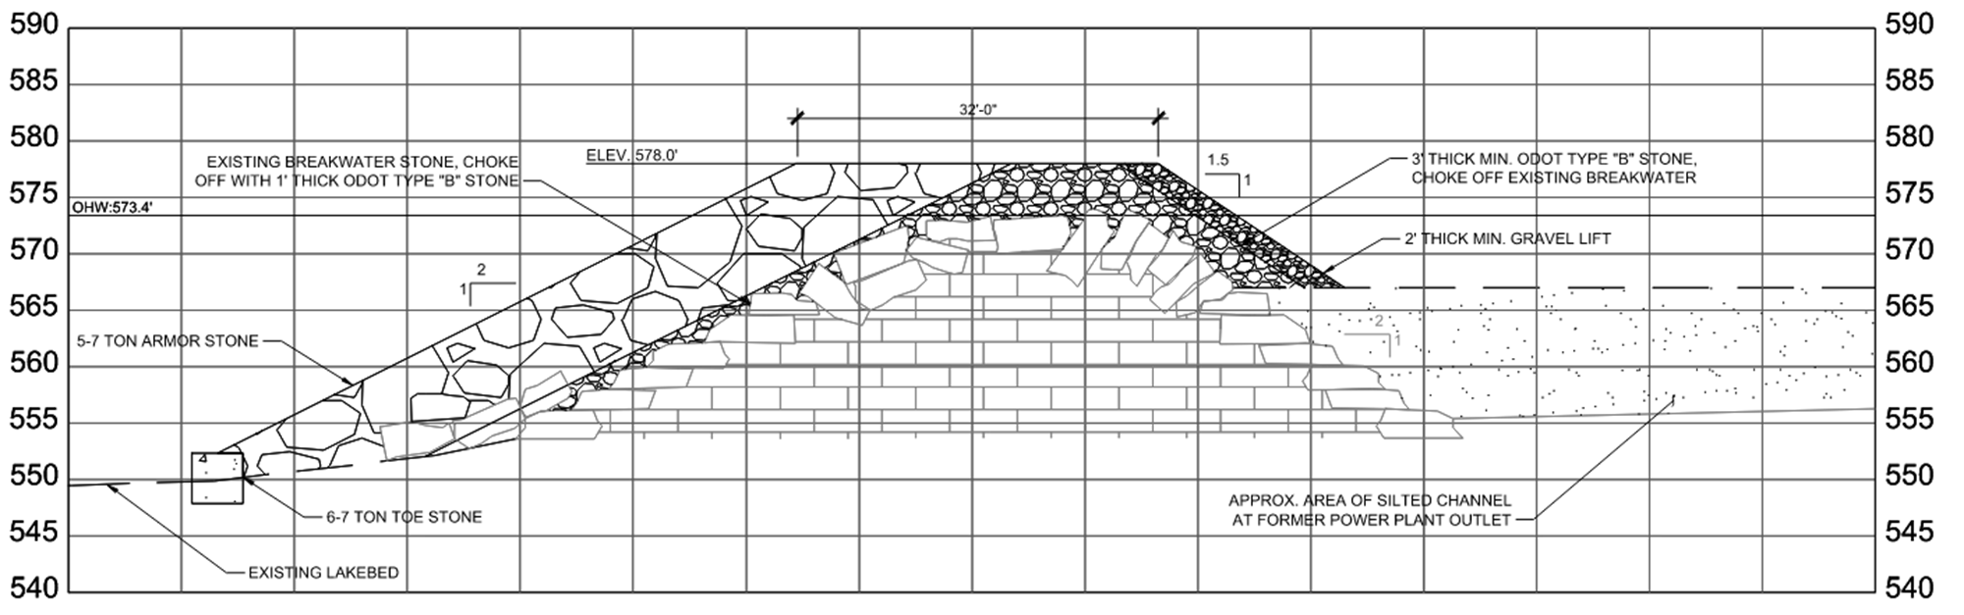
Early Action Update
Permitting strategy may adjust based on funding source – official project purpose
Early Action Project Presented to USACE (Planning, Operations & Engineering) 10/6/2025
Continuing to meet with USACE Regulatory

Slide 8
Regulatory + Permitting
Updates

Slide 9
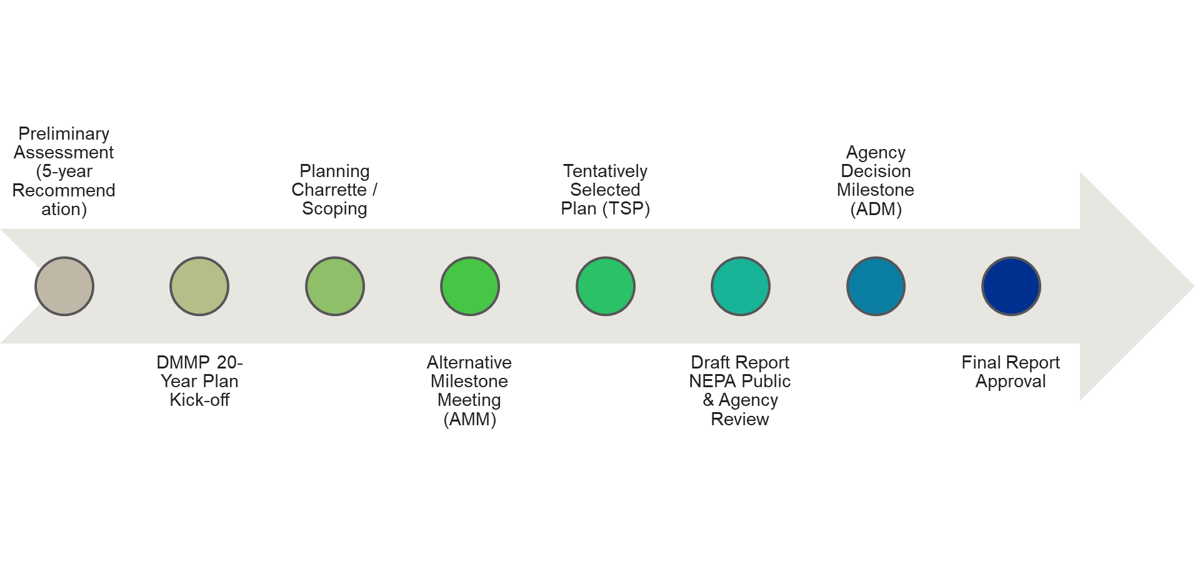

USACE – DMMP Schedule
25 Nov 2024
1 Oct 2024
22 Oct 2024
23 Sept 2025
March 2027
Sept 2027
Nov 2027
Sept 2029
Alternatives Milestone Meeting completed 23 Sept 2025 – confirms focused array and remaining study scope
Ongoing - AMM to TSP will include investigation on focused array of alternatives, design refinement, and partner coordination
Notes:
New early finish date for final report approval is April 2029!

Slide 10
USACE – Path to TSP
Data collection –
  sediment sampling and analysis in channel, harbor, ,and proposed in-lake placement locations
  Ecological surveys for nearshore areas of Lake Erie
  CDF sediment characterization
  Nearshore hydraulic conditions to support coastal monitoring
Environmental compliance –
  Issue Notice of Intent & Public Scoping Period
  CZMA determination,
  Clean Water Act compliance
  Identify and characterize mitigation requirements
Beneficial Use of Dredged Material Measure Development
  Identify and validate end user(s) for CDF harvested material
Engineering and Modeling
  Coastal modeling
  Ecological modeling
  Cost estimates
Economic analyses

Slide 11
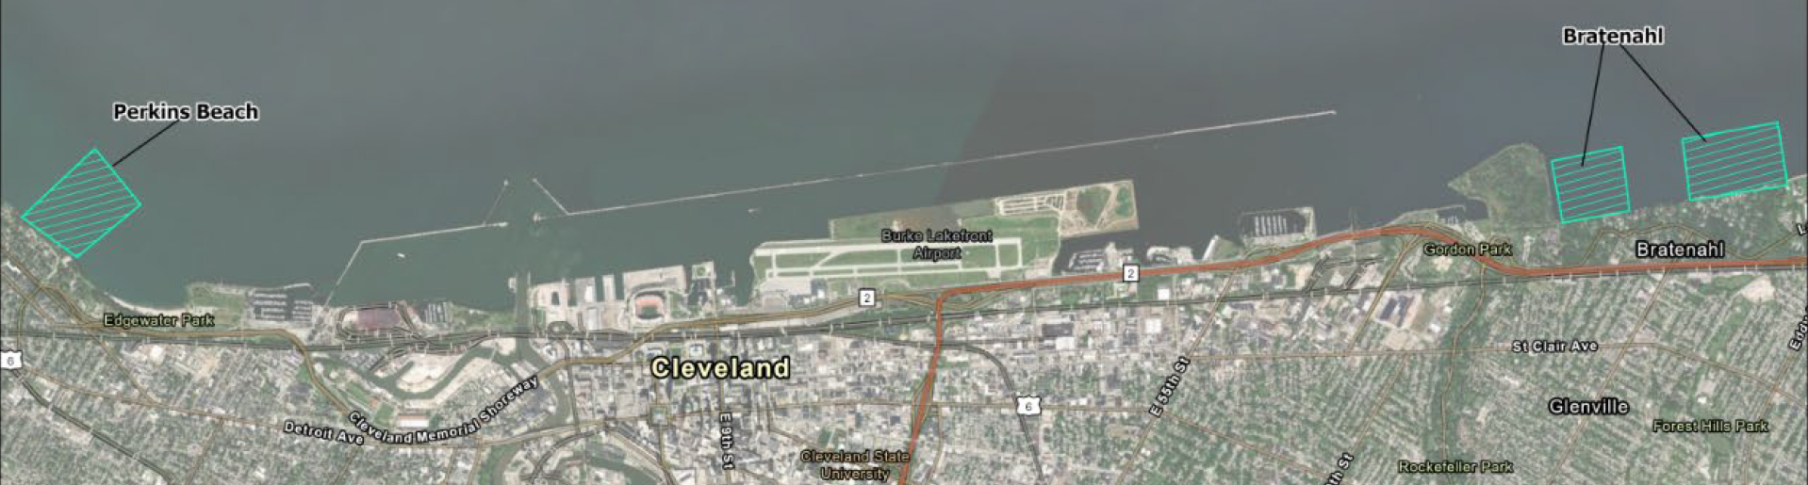
USACE DMMP Preliminary Assessment Addendum
USACE added an additional proposal to the pending Dredged Material Management Plan (DMMP). Their proposal identifies three sites for littoral placement (offshore deposits of dredge material).
After review, the CHEERS partners do not see any benefits to this proposal. It detracts from proceeding with CHEERS in a timely manner to address the urgent pending lack of capacity at the end of 2028.
Thank you to those who submitted letters!

Slide 12
Recent Deliverables

Slide 13
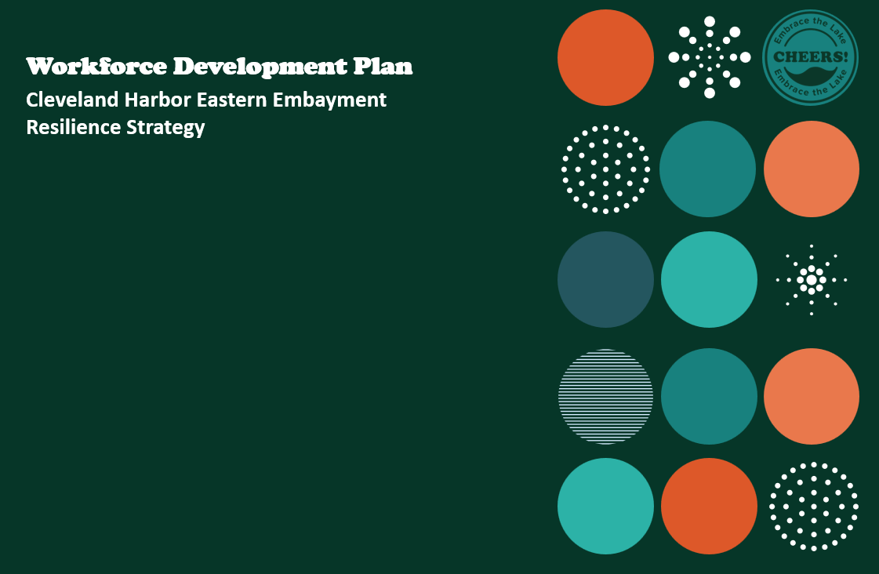

Slide 14
Timeline
Final Workforce Development Plan to be completed at the end of March!
Updated CHEERS phasing strategy
Evaluated existing workforce development organizations
Identified local stakeholders for outreach
Hosted workforce development table at Eastside Lakefront Open House
Held workshop with 13 participants across seven Cleveland workforce development organizations
August
September
October
November
December
January
February
Mapped project-specific workforce requirements
Conducted interviews with 13 organizations
Defined workforce development goals and opportunities
Conducted skills gap analysis
Began drafting framework
Draft
Plan Complete!

Slide 15



Contents
1
Introduction
2
Goals
3
Workforce Needs
4
Workforce Development
Directory
5
Career Pathways Guide
6
Conclusion

Slide 16
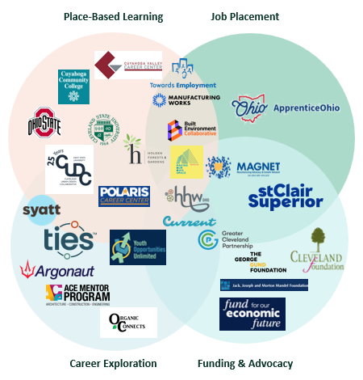
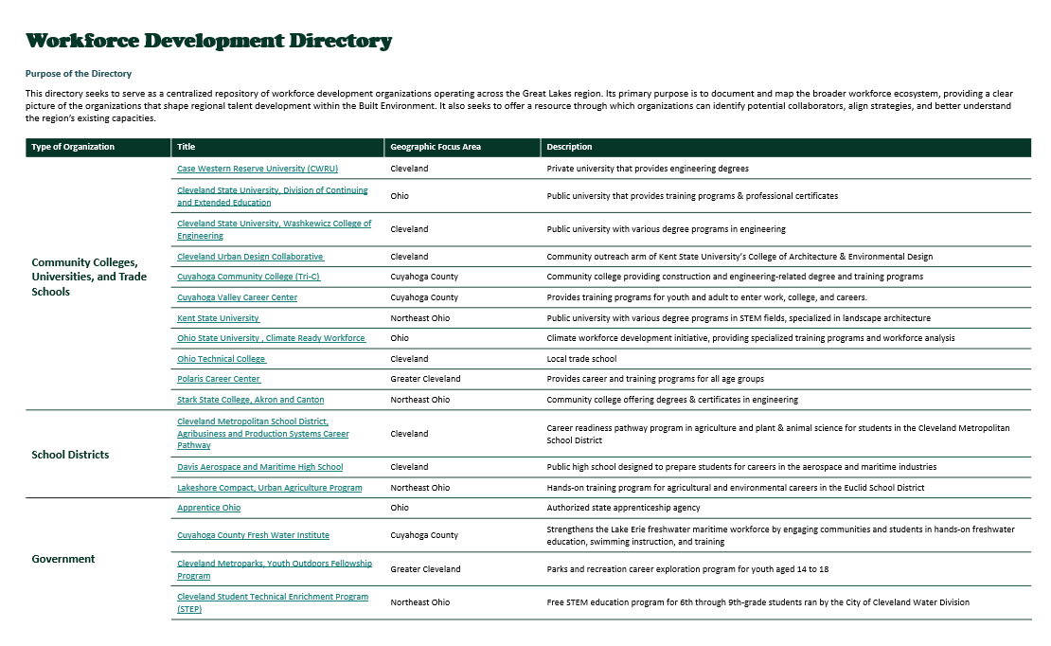
Workforce Development Directory
Purpose: Provide a centralized repository of workforce development organizations operating across the Great Lakes region.

Slide 17
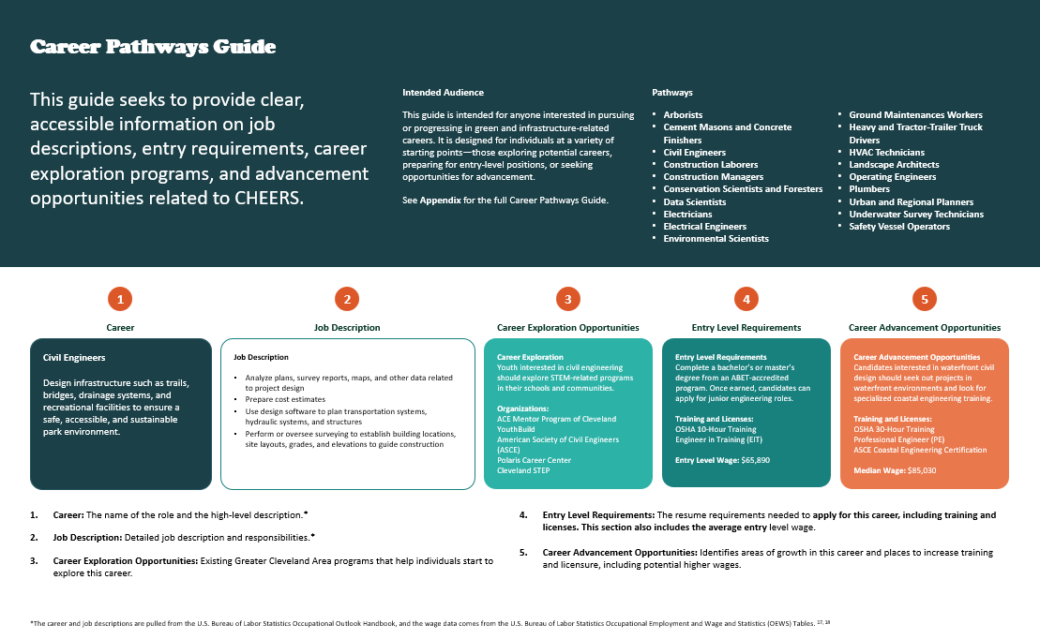
Career Pathways Guide
Purpose: Provide clear, accessible information on job descriptions, entry requirements, career exploration programs, and advancement opportunities related to CHEERS.

Slide 18
Updated Graphics

Slide 19
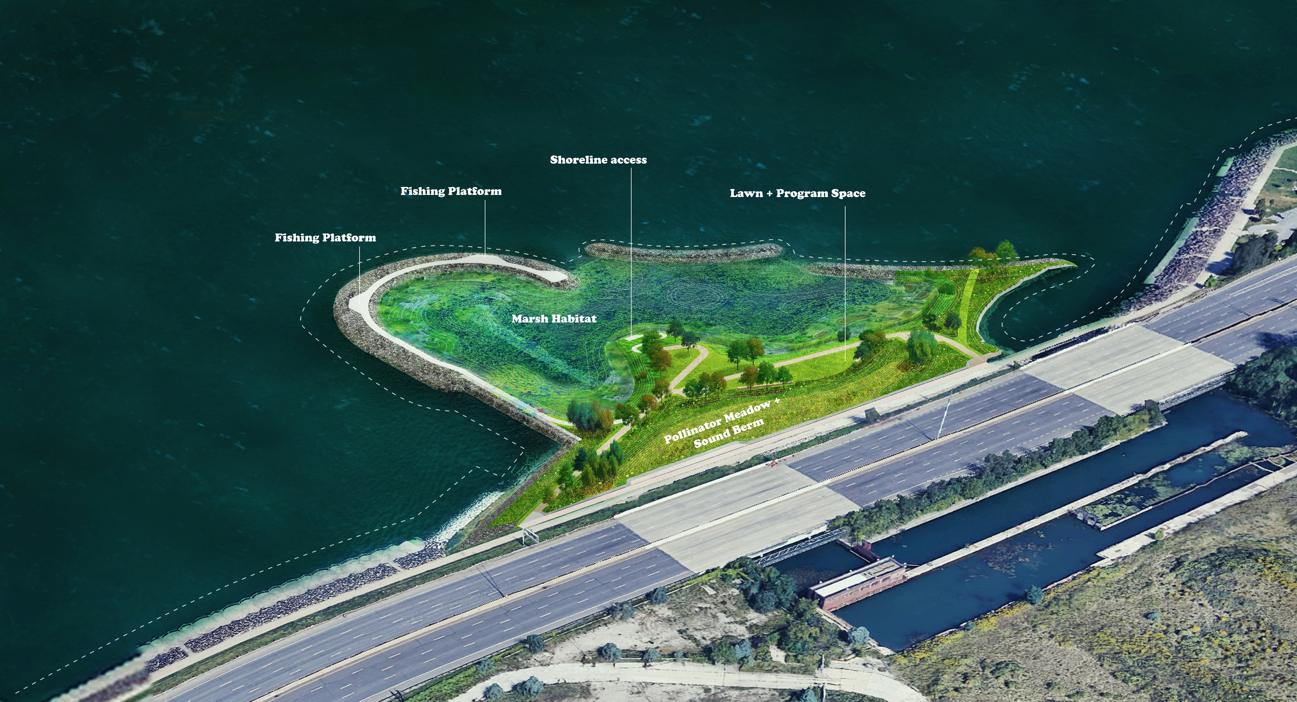

Slide 20
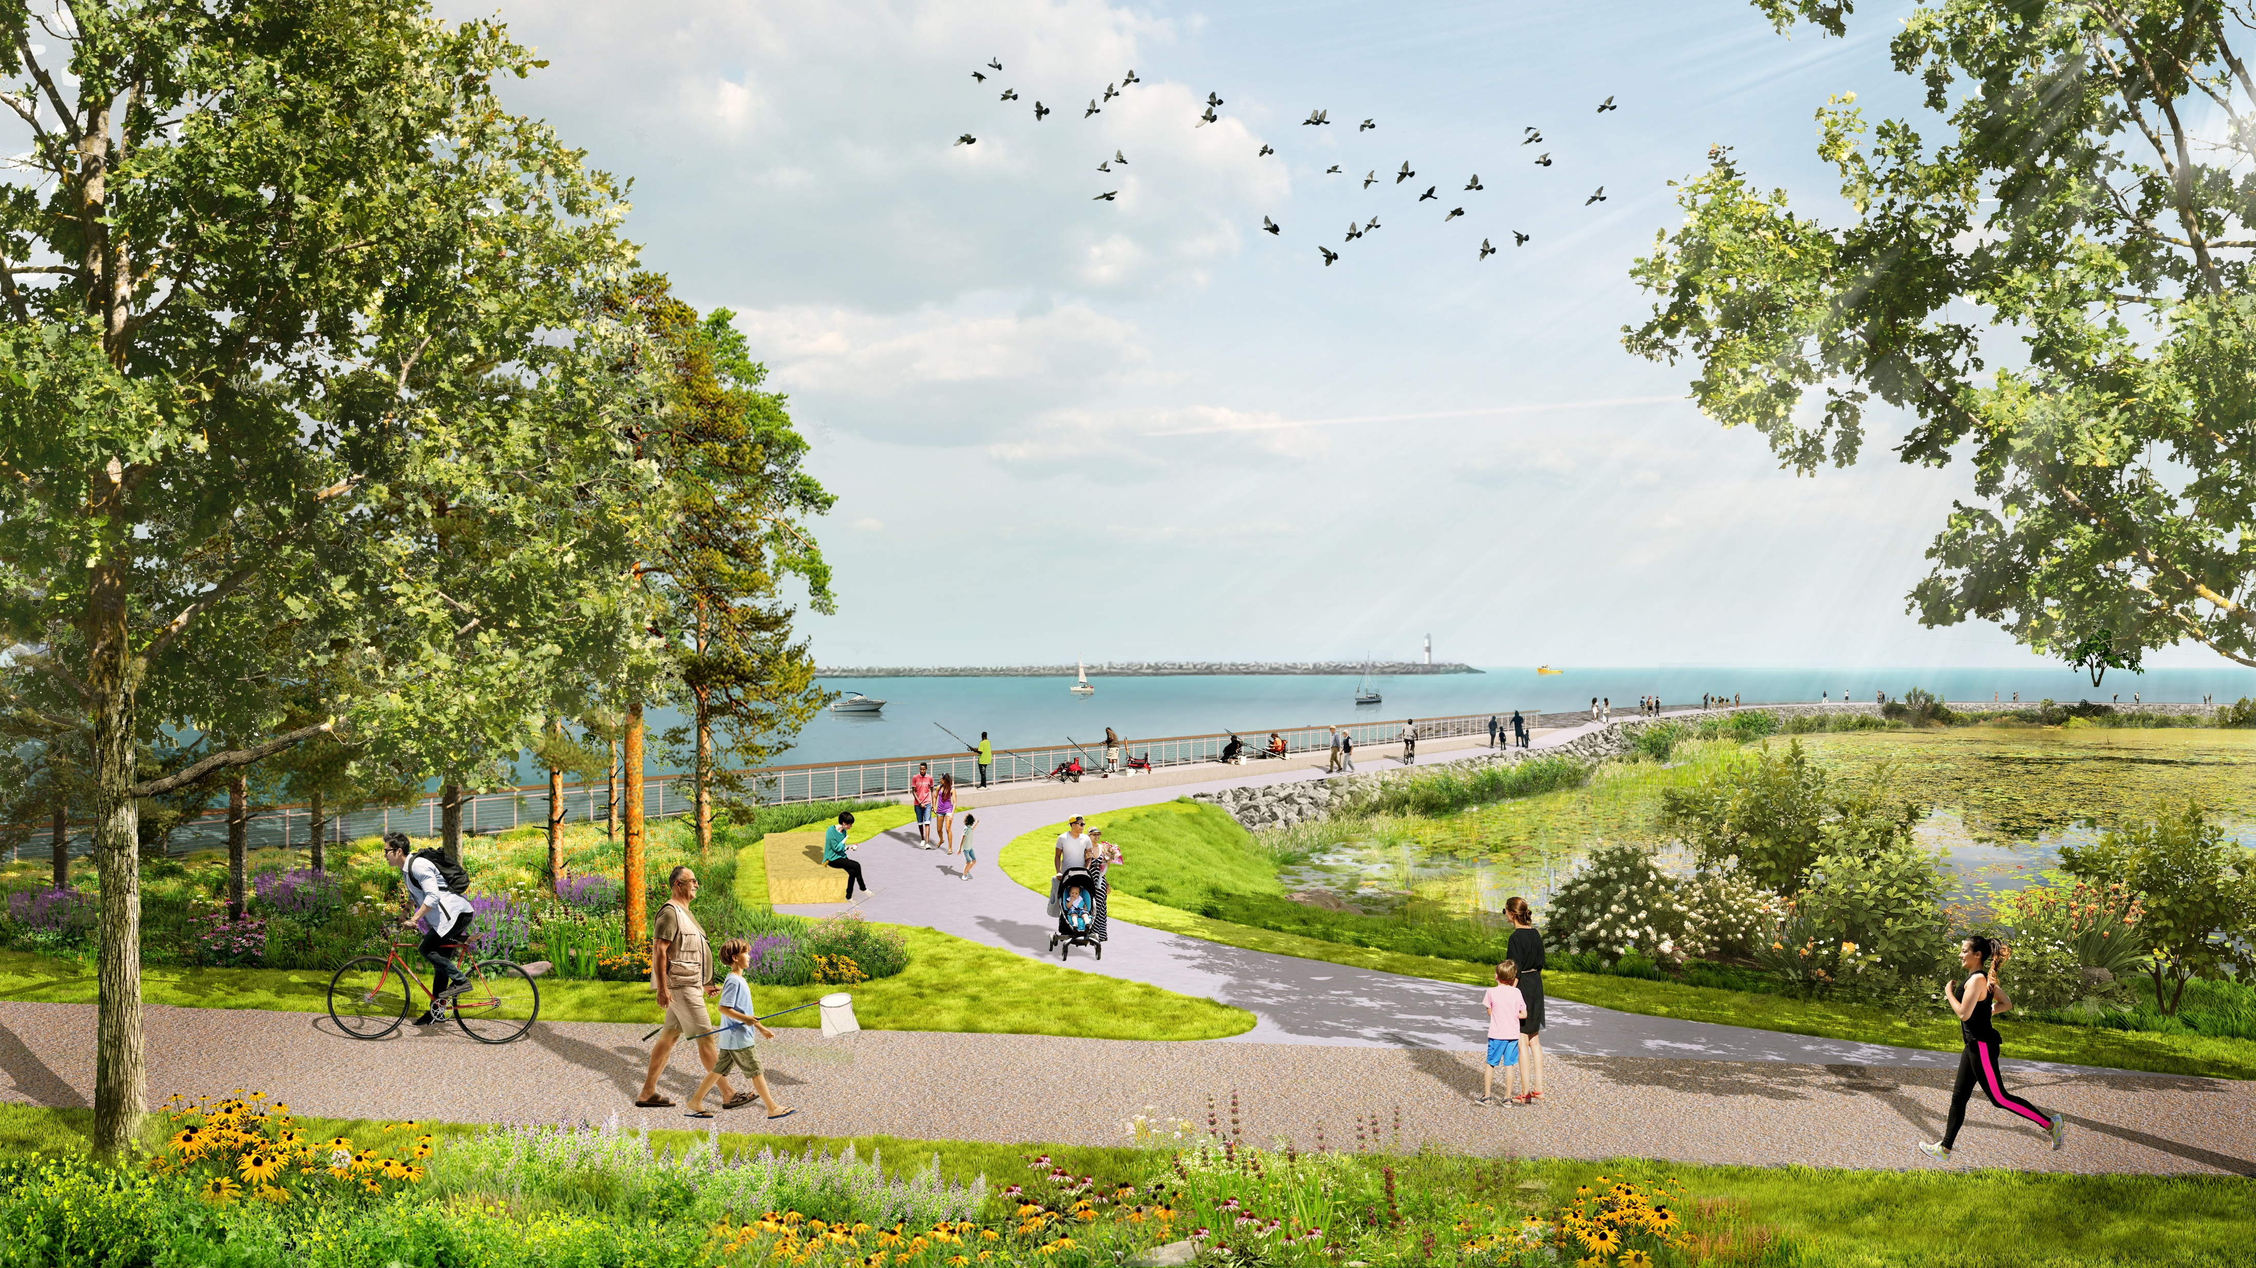

Slide 21
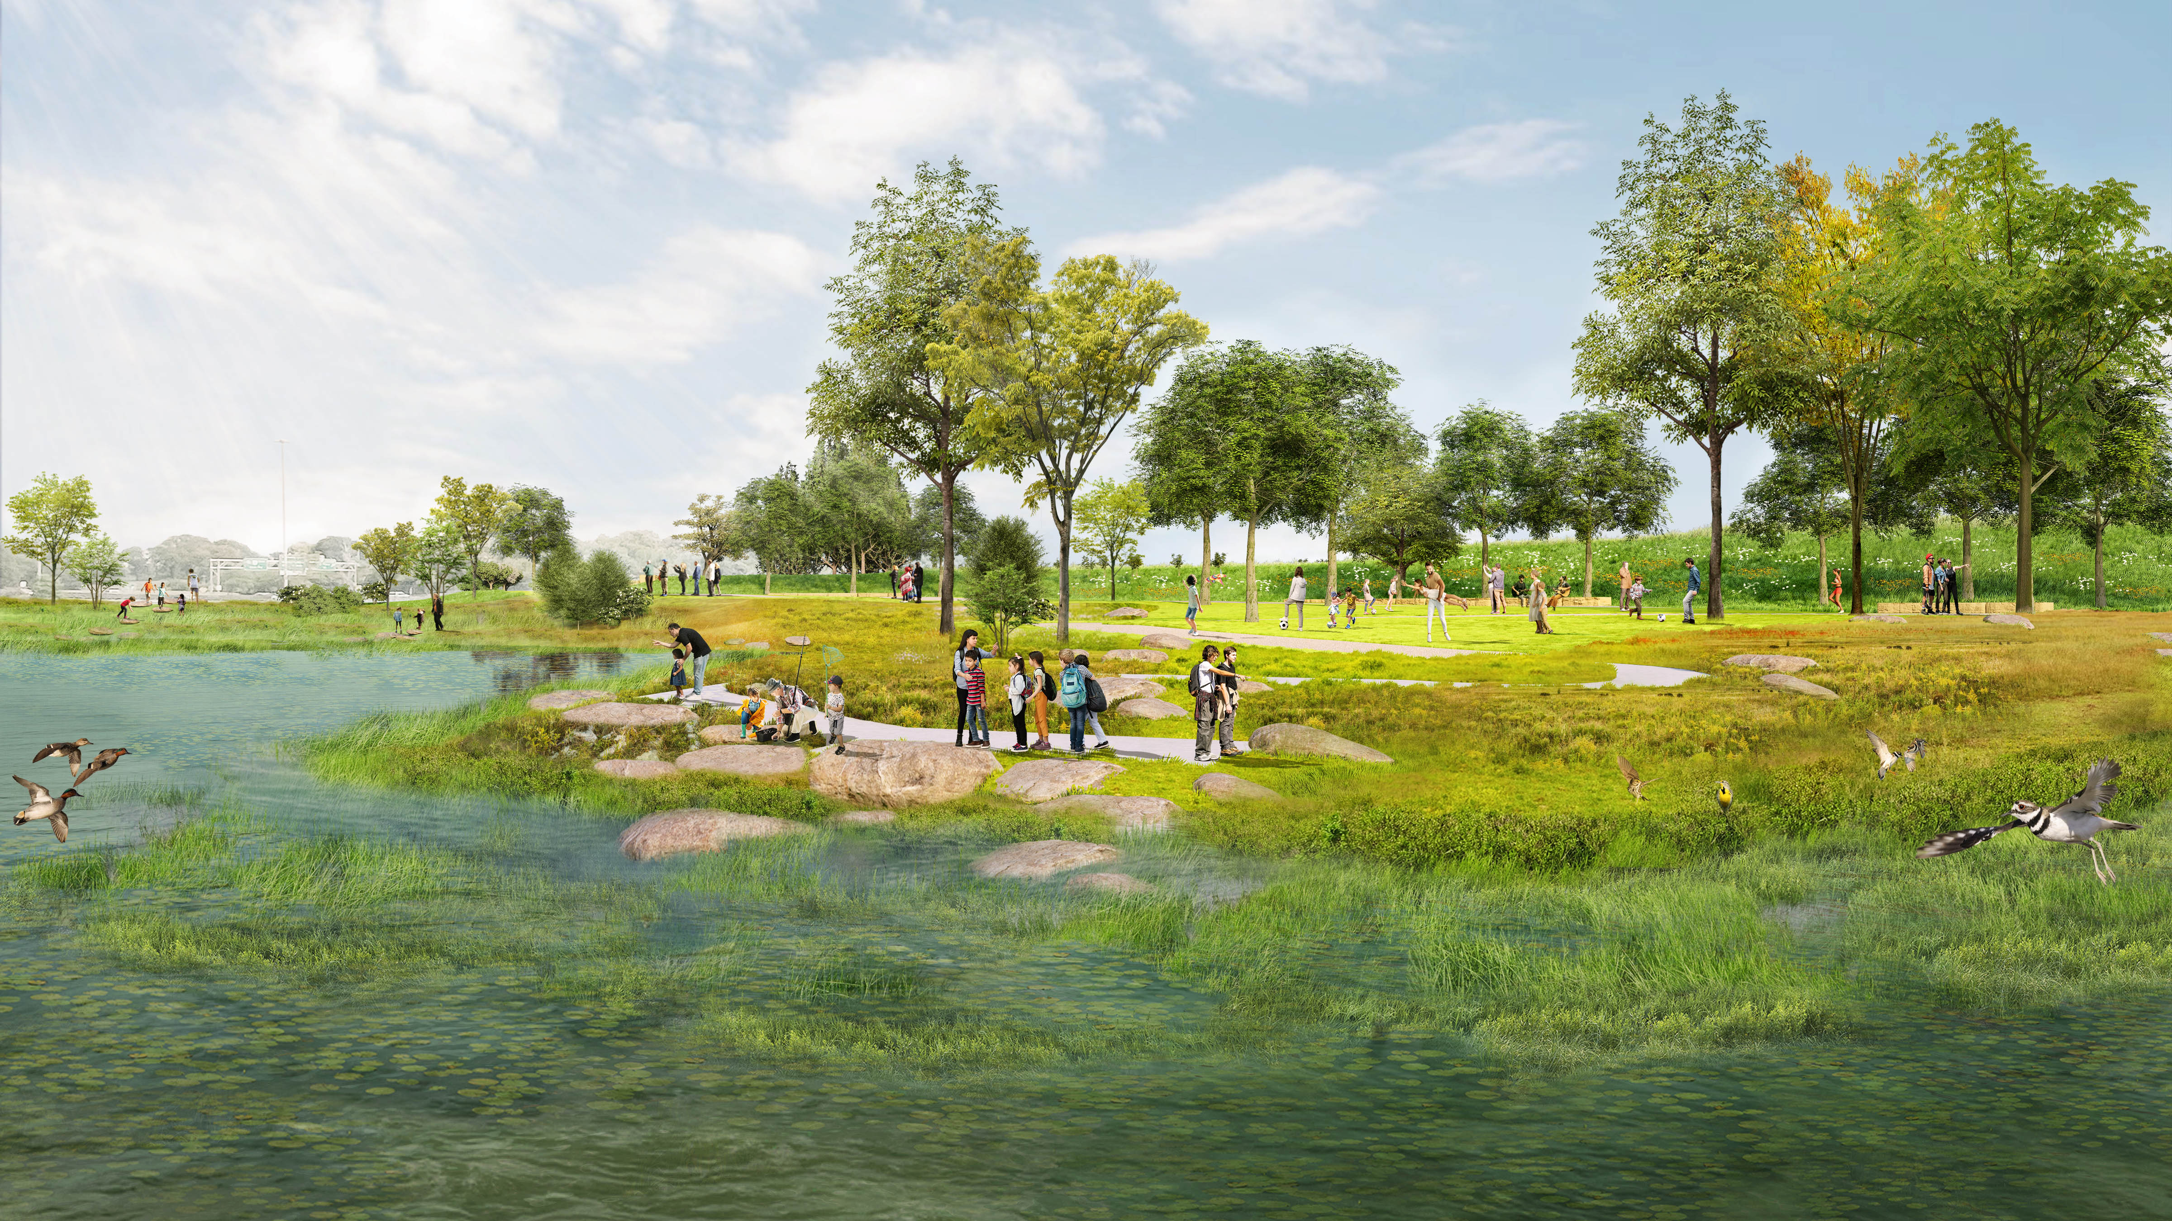

Slide 22
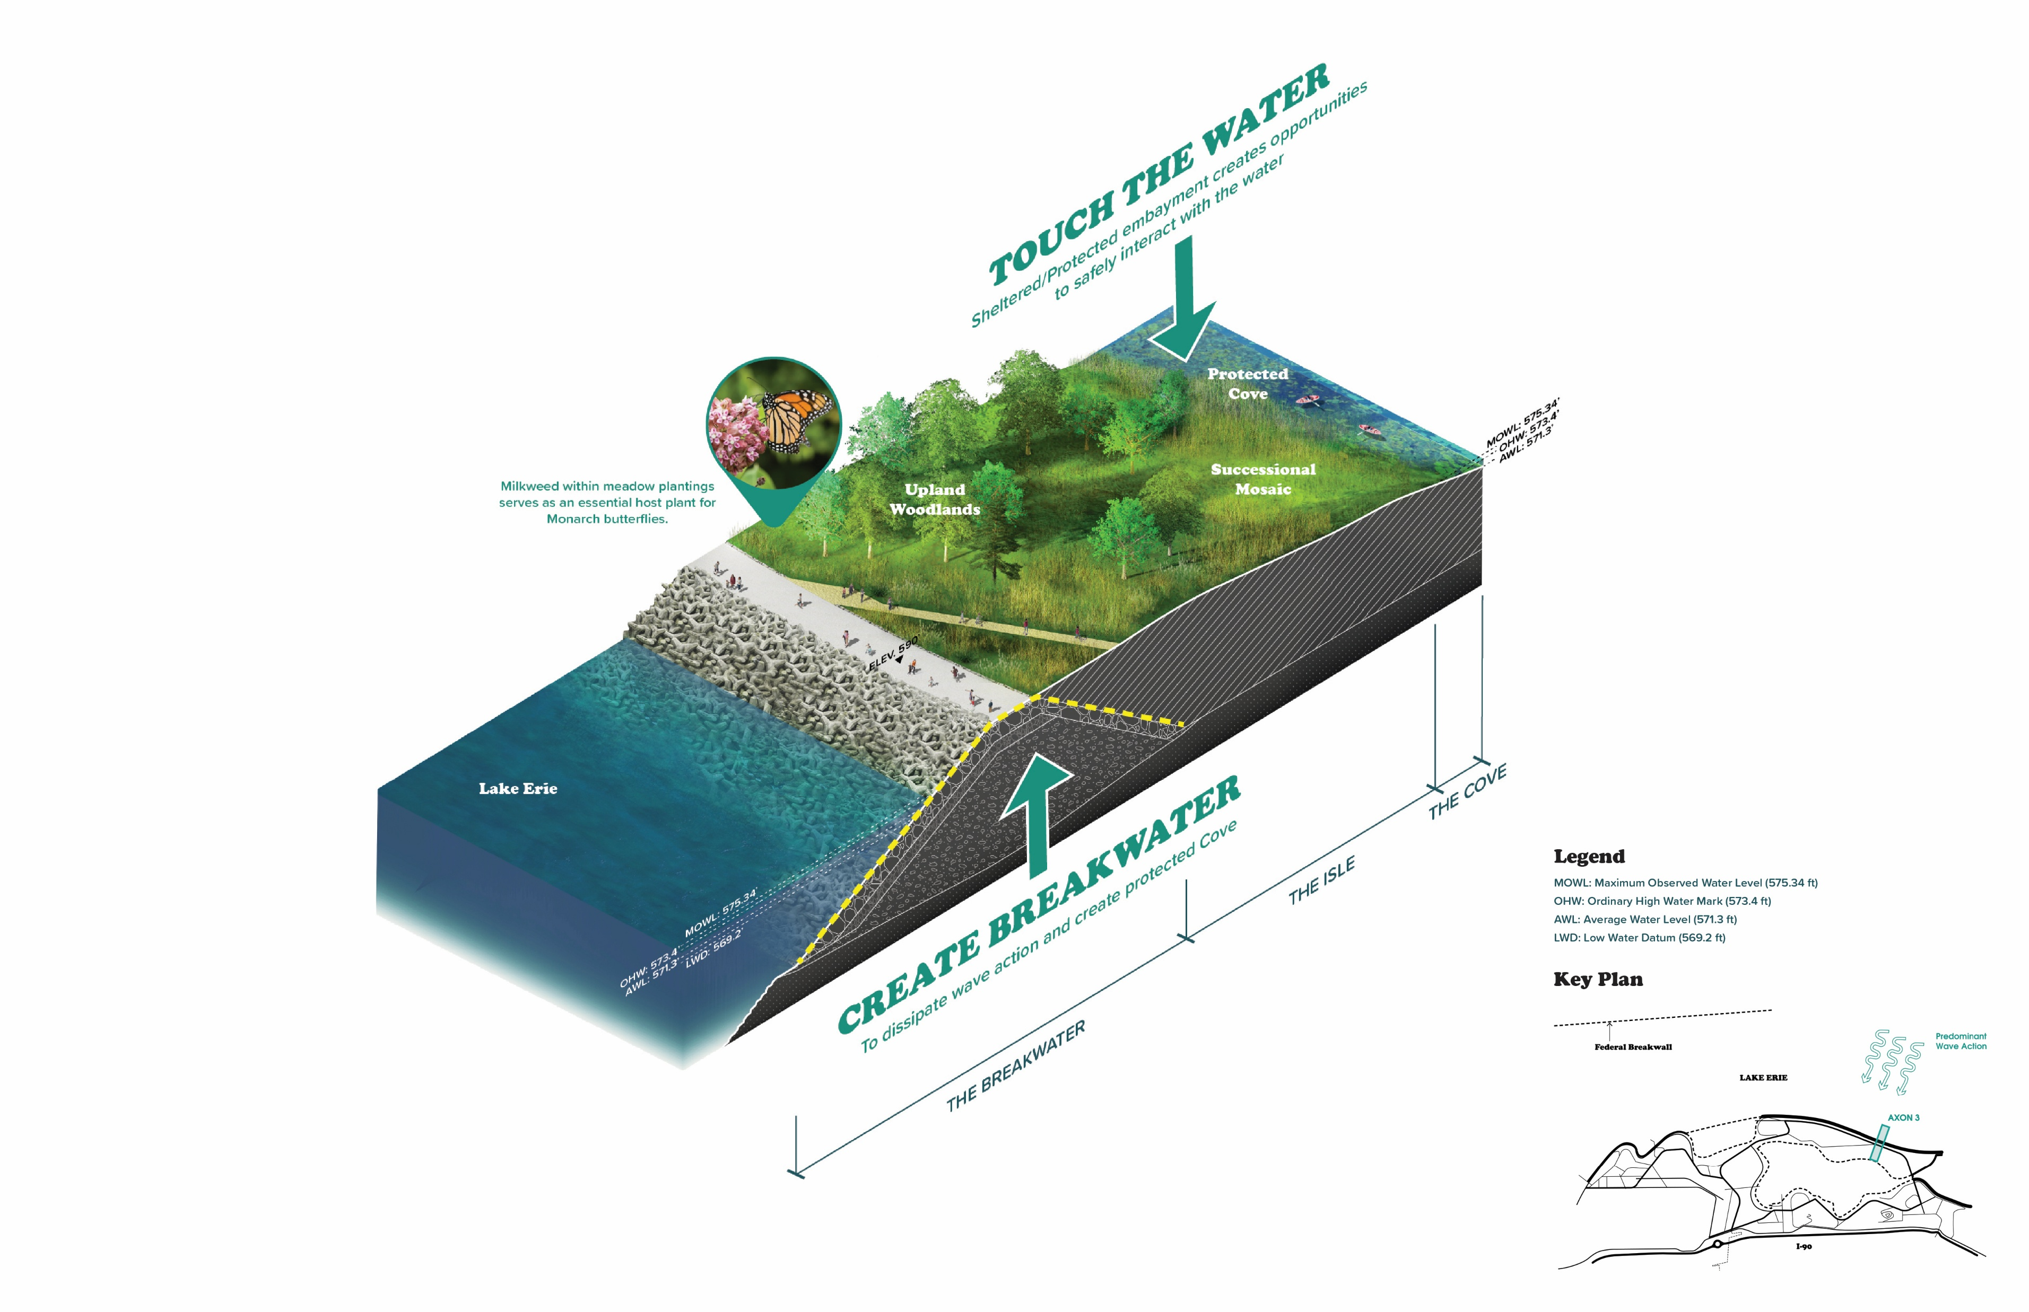

Slide 23
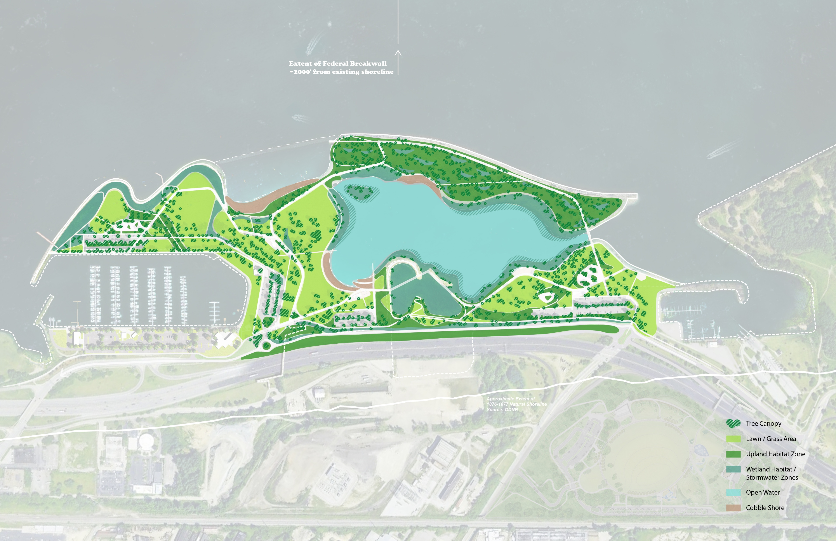

Slide 24
Stakeholder Updates

Slide 25
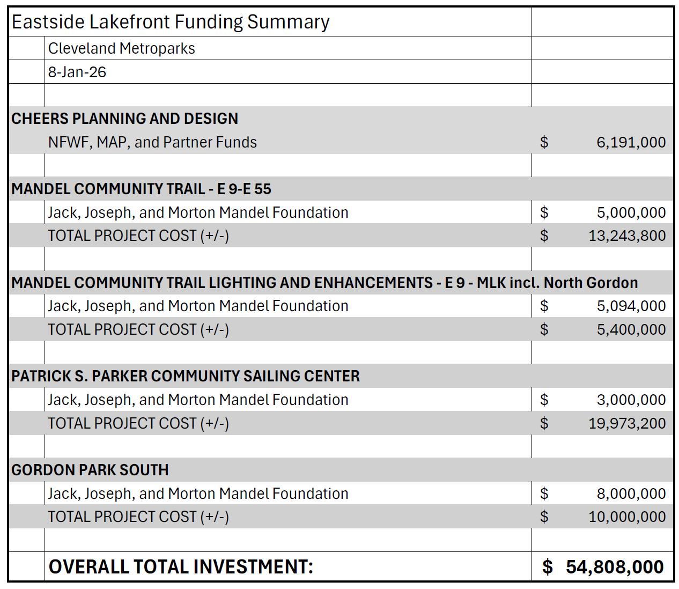
Partner Updates
BEL – IYC Resilience Hub Study
Port – Continued advocacy
City of Cleveland
City Council hearings regarding the future of Burke Lakefront Airport
ODOT –
ODNR –
Cleveland Metroparks:
Reconnecting Communities Technical Assistance
Sailing Center on track for early summer completion
NEORSD CSO relocation construction to begin in 2027
Mandel Community Trail E 55 – MLK lighting will begin this summer
North Gordon gateway improvements this summer
Gordon Park Phase 1 construction late spring

Slide 26
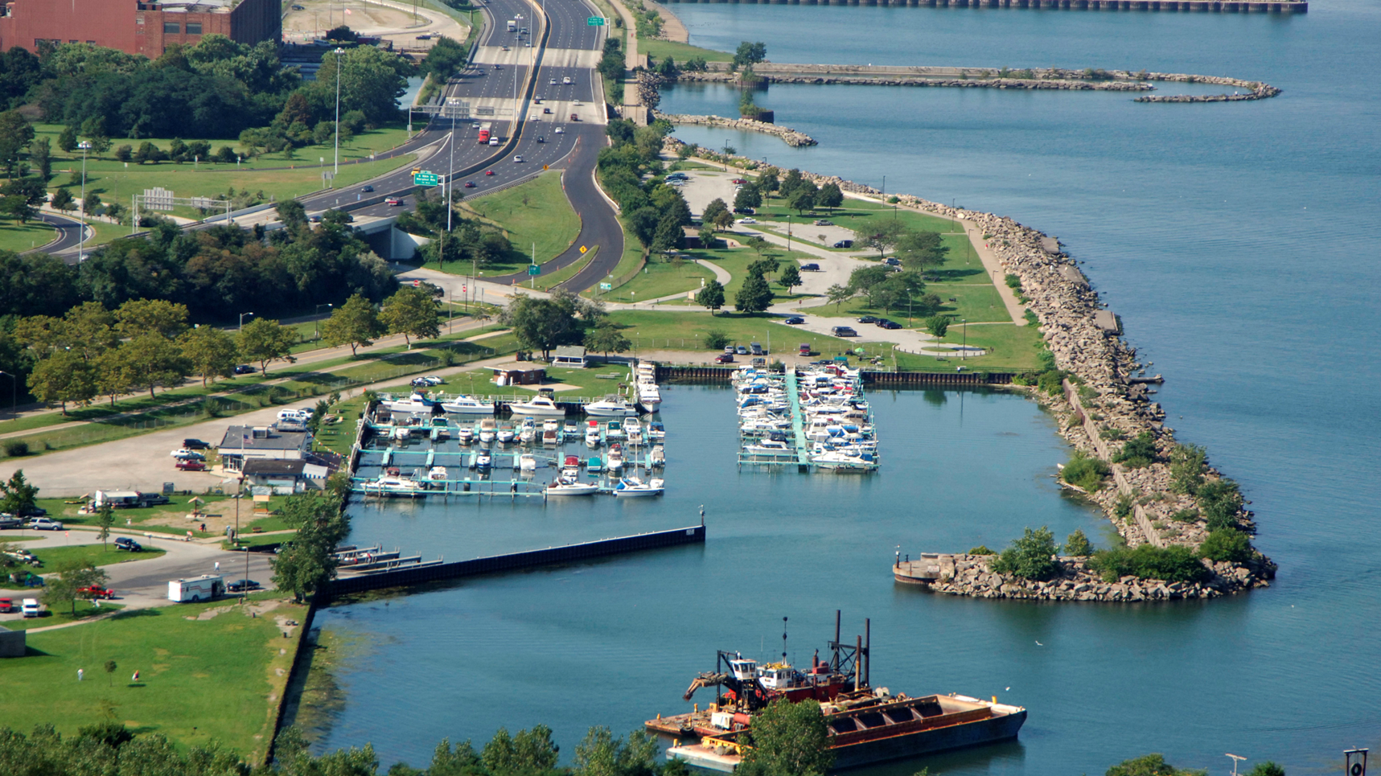
IYC Resilience Hub

Slide 27
Ongoing Communications
How would you like to stay connected?
Let us know if you would prefer email updates in the future. We will send a follow up email after today's meeting to confirm folks would like to stay on our distribution list.
Thanks!

