Slide 1
Financial Performance
for the Period Ended
July 31, 2026

Slide 2
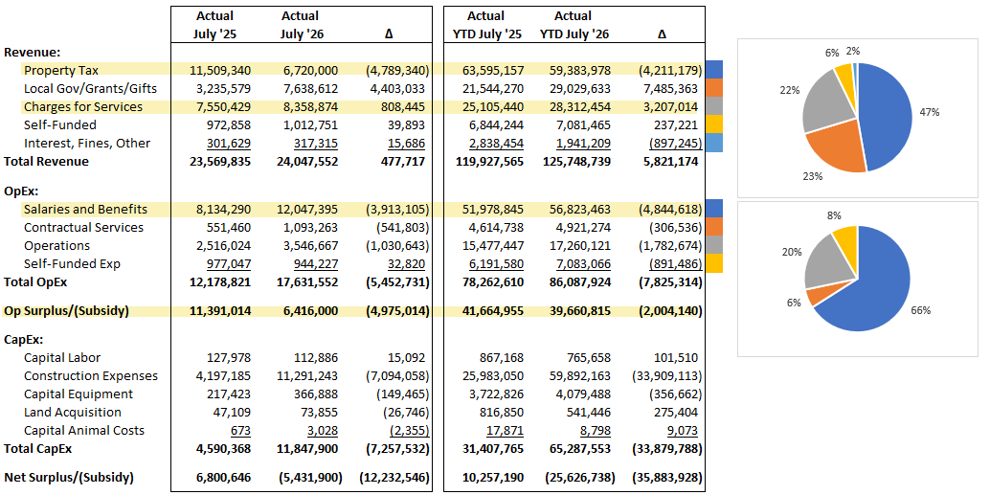
Cleveland Metroparks as a Whole

Slide 3
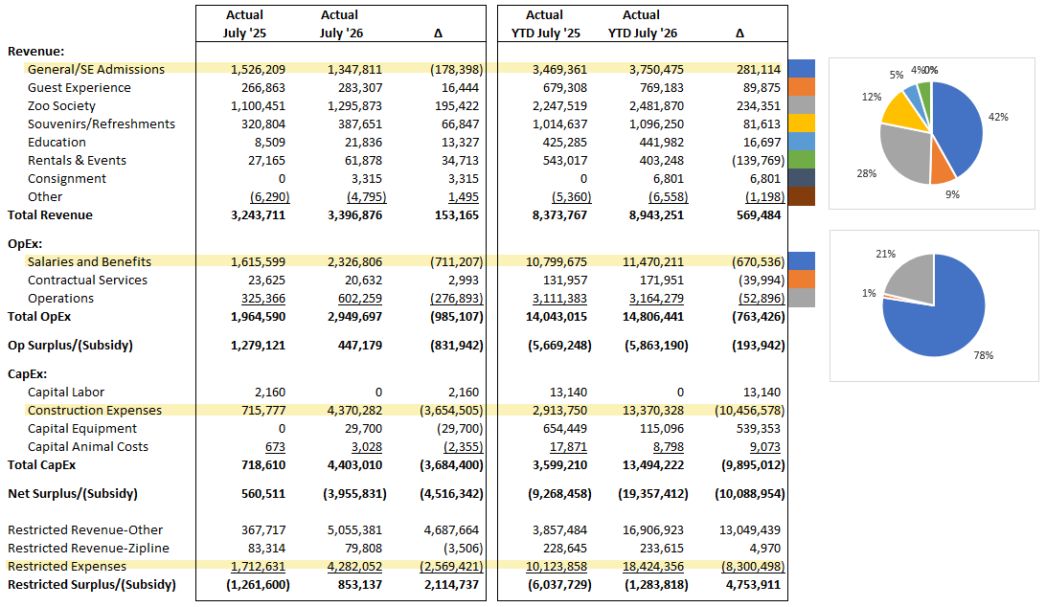
Cleveland Metroparks Zoo

Slide 4
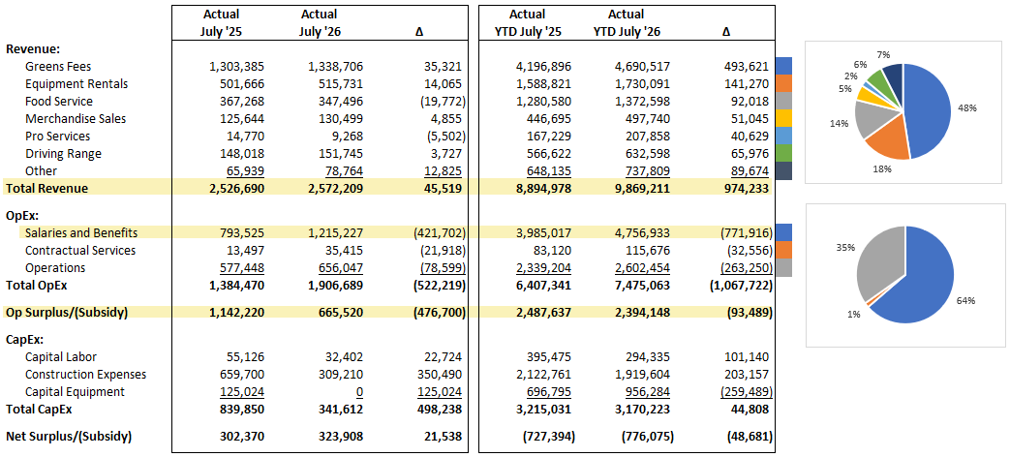
Cleveland Metroparks Golf Division

Slide 5
Cleveland Metroparks Golf Courses (YTD)

Slide 6
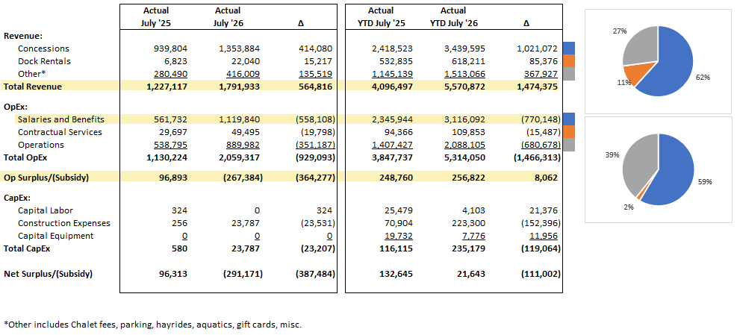
Cleveland Metroparks Enterprise Division

Slide 7
Cleveland Metroparks Enterprise Locations (YTD)

Slide 8
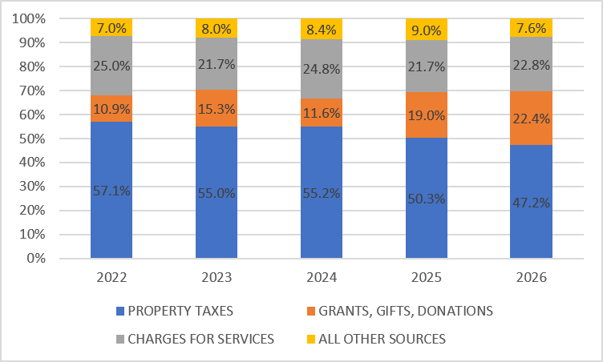
Cleveland Metroparks Funding Sources

